Slide 1
Fluory: A reactive programming language
By Molnar Ivan

Slide 2

Temp check

Slide 3
Let’s start with some history

Slide 4
- 1940s, The first programming language

Slide 5
- 1940s, The first programming language
- 1950s, The first high level programming language

Slide 6
- 1940s, The first programming language
- 1950s, The first high level programming language
- 1960s, Object oriented programming

Slide 7
- 1940s, The first programming language
- 1950s, The first high level programming language
- 1960s, Object oriented programming
- 1970s, C got released

Slide 8
- 1940s, The first programming language
- 1950s, The first high level programming language
- 1960s, Object oriented programming
- 1970s, C got released
- 1980s, Python

Slide 9
- 1940s, The first programming language
- 1950s, The first high level programming language
- 1960s, Object oriented programming
- 1970s, C got released
- 1980s, Python
- 1990s, JavaScript & PHP

Slide 10
- 1940s, The first programming language
- 1950s, The first high level programming language
- 1960s, Object oriented programming
- 1970s, C got released
- 1980s, Python
- 1990s, JavaScript & PHP
- 2000s, .NET

Slide 11
- 1940s, The first programming language
- 1950s, The first high level programming language
- 1960s, Object oriented programming
- 1970s, C got released
- 1980s, Python
- 1990s, JavaScript & PHP
- 2000s, .NET
- 2010s, Rust

Slide 12
- 1940s, The first programming language
- 1950s, The first high level programming language
- 1960s, Object oriented programming
- 1970s, C got released
- 1980s, Python
- 1990s, JavaScript & PHP
- 2000s, .NET
- 2010s, Rust
- 2020s, Fluory ?

Slide 13
Traditional program
Fluory
A = 5
B = A + 2
A = 2
Result: B == 7
A = 5
B = A + 2
A = 2
Result: B == 4

Slide 14
Think different

Slide 15
K. I. S. S.
KEEP
IT
SUPER
SIMPLE
KEEP
IT
STUPID
SIMPLE

Slide 16
Structural Changes
A = [1, 2]
for(10):
A.add(A[len(A)-2] + A[len(A)-1])
A = 1
B = 2
C = []
for(10):
C.add(A).add(B)
A=A+B
B=A+B

Slide 17
Everything is global scope
A = 5
If ( true ) {
B = A
}
C = 1
A = C
So… B == C ?
But what is a scope?

Slide 18
ASYNC MADE SIMPLE

Slide 19
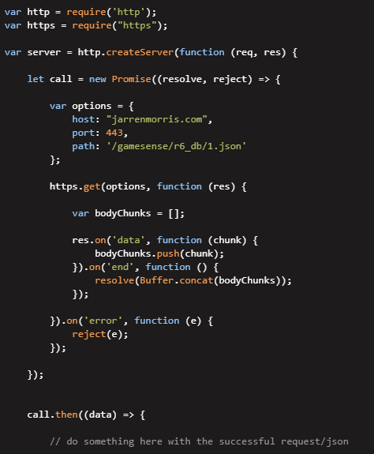
The saviour of UI connectors
Single request

Slide 20
How is this not yet a thing?
It's more-or-less is?

Slide 21
The competition
Project RED
Packages (Mostly JavaScript)
RxJs, LemonJs, SolidJs, ArrowJs

Slide 22
Different isn’t always good for an established market..

Slide 23
But should this be a thing?
ABSOLUTELY !

Slide 24
Question?

Slide 25
Compilers
VS
Interpreters
Efficient but complicated
Inefficient but doable
Good for modelling
Even more complicated words….

Slide 26
Fluorine, one of the two most reactive elements
Cesium is more metal, but it was already taken….

Slide 27
I’m sorry, but a bit of vocabulary

Slide 28
A Programming language:
A programming language takes the form of text that is structured enough to be translated to computer language but english-ish enough to be understandable by a human.

Slide 29
A variable:
In programming, a variable is a container for a value. This value can be anything be it numbers, text, lists, etc.

